Slide 1

MTH393A
Statistical Downscaling using Deep Learning of Rainfall Data Over Indian Region

Slide 2
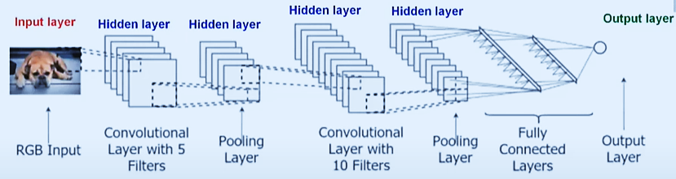
CNN (Convolutional Neural Networks): A neural network that uses convolution.
Introduction
The inputs are images which are convolved by a kernel of preferably smaller size in CNN.
To perform convolution, the kernel goes over the input image, doing matrix multiplication element after element.
The result for each area where convolution takes place, is written down in the feature map.
Convolutional Layer: Used to extract features from the input image.
Pooling Layer: Applies an activation map on the convolved feature.
Fully Connected Layer: Performs classification based on the features extracted by the previous layers.
Notes:
It is just a neural network that uses convolution. Convolution is a mathematical operation on 2 functions that produces a third function expressing how the shape of one is modified by the other.

Slide 3
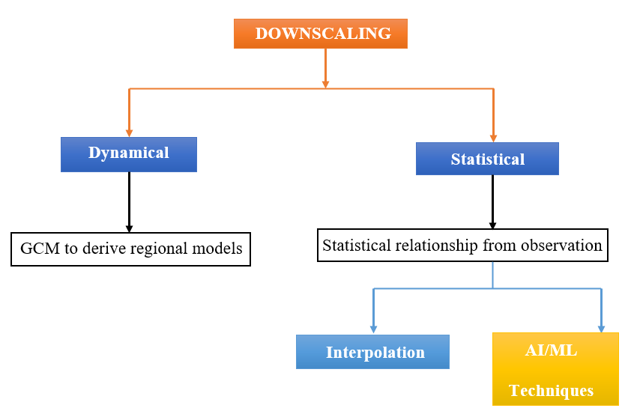
DOWNSCALING:
Downscaling is needed for -
1) To generate high resolution data and 2) To get local scale projections.

Slide 4
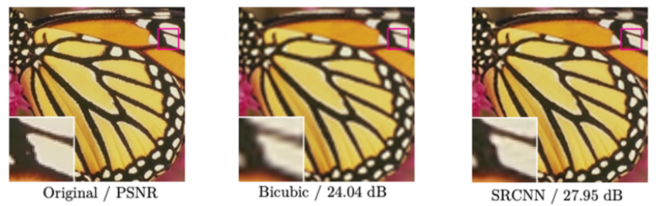
Background
SRCNN (Super resolution convolutional neural network): -
Process of upscaling and / or improving the details in an image.
SR methods aim to accurately estimate a high-resolution image (HR) from a given low-resolution (LR) image.
It utilises a CNN as a mapping function from LR input to high resolution output.
The resolution in SRCNN is better than the other method.

Slide 5
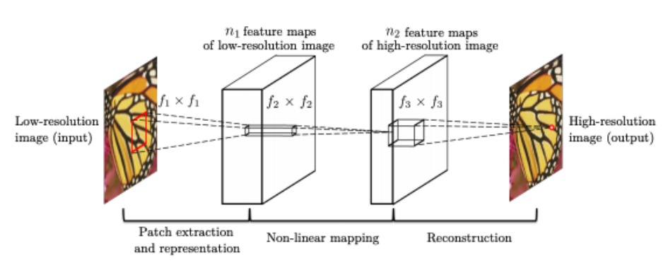
SR using SRCNN: Formulation of the neural network for SRCNN-
Given a low-resolution image Y, first convolutional layer of SRCNN extracts a set of feature maps.
Second layer maps these features nonlinearly to high resolution patch representations.
The last layer combines predictions within a spatial neighbourhood to produce the final high resolution image F(Y).
SRCNN performs better than conventional models on meteorological data (Vandal et al. IJCAI 18).

Slide 6
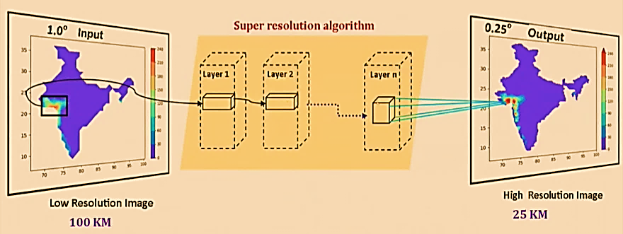
SRCNN on meteorological data:
LR image – Made some patches – Pass them to hidden layers – Get a patch for HR image
Then keep generating the HR image of all the patches to generate the final HR image.

Slide 7
Methods
SRCNN Algorithm:
Input is 1.0◦ data and label are 0.25◦ data. Label data means how the data is being trained.
Sliced into small images or patches (Patch extraction)
64 pieces (8 vertical and 8 horizontal) of size 35 x 35.
This small image then enters the convolution layers
(3 layers) output image to a size of 23 x 23.
CNN architecture can be designed to learn a functional mapping LR and HR using 3 operations-
Patch extraction
Non-linear mappings
Reconstruction
First layer has 64 filters of kernel size of (9,9)
Second layer has 32 filters → kernel size of (1,1)
Third layer has 1 filter → kernel size of (5,5)
Activation function PReLU is used in all the three layers.

Slide 8
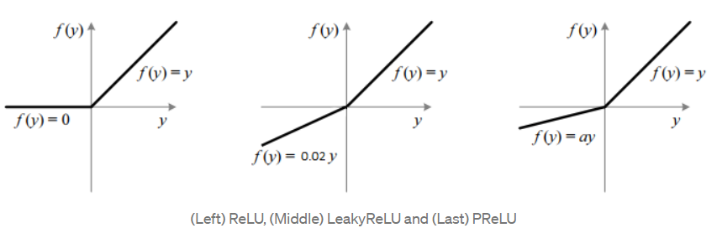
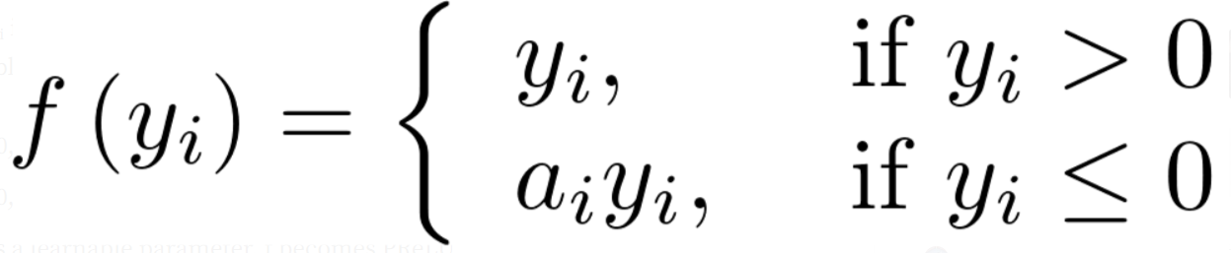
Parameters used in SRCNN:
Activation function = PReLU
Kernel Initializers = GLOROT Normal, Random Normal, Truncated normal. (initialise the weights of the neural networks)
Optimizer = ADAM (adapts to the gradient descent after every iteration to remain controlled and unbiased throughout the process)
Loss function = Mean squared error (MSE)
Epoch = 500 (due to limitation of available resources) (1-time iteration from backward-forward iteration)
Batch size = 20 (The number of training egs. present in a single batch)
Learning rate = 10⁻⁴ (Iteration is the no. of batches needed to complete 1 epoch)
In every iteration, the output value from previous iteration is compared with the current one and the difference is checked. If the difference is found less that a particular threshold value, the iteration is stopped.
When the iterations went upto10⁻⁴, the training was stopped.
No. of years of data = 10 Years (1995 – 2004)

Slide 9
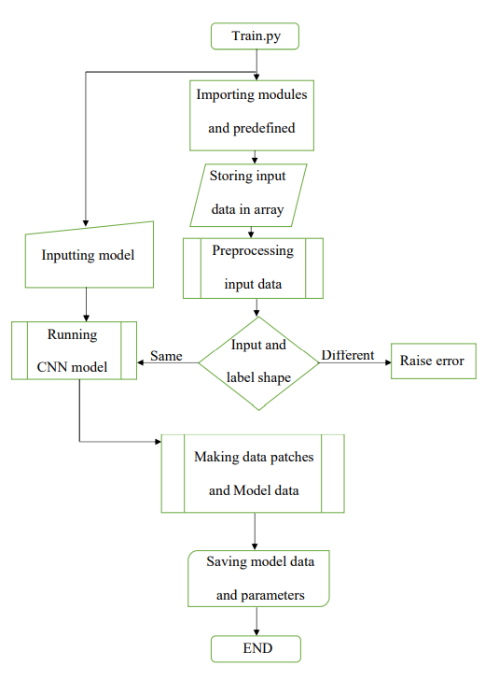
Flowchart: Model Training

Slide 10
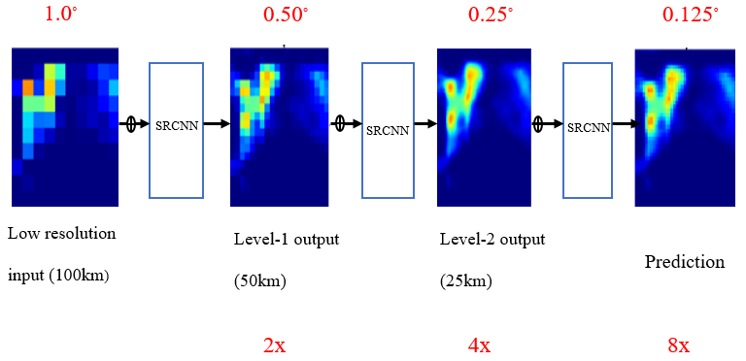
Stacked SRCNN:
Traditional SR methods are built for resolution enhancements of factors from 2 to 4.
Statistical downscaling conservatively requires resolution increases of factors from 8 to 12.
Rather than enhancing resolution directly to 8 – 12x, “Stacked SRCNN” can be used to increase the resolution by a factor of ‘x’.
In this, each SRCNN is trained independently using their respective input/output resolutions and stacked at test time.

Slide 11
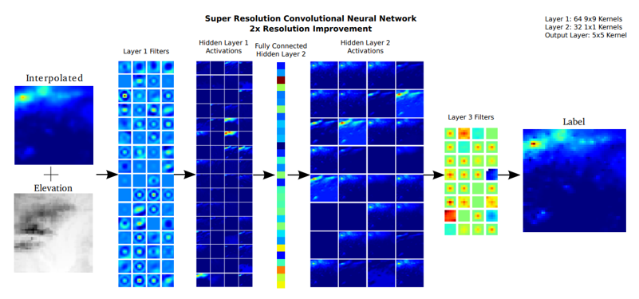
DeepSD:
It is used for getting benefit of more variables.
It augments SRCNN with multiscale channels to maximise predictability in statistical downscaling.
When downscaling precipitation, there are two types on inputs including low resolution (LR) precipitation and static topographical features such as HR (high resolution) elevation and land/water masks to estimate HR precipitation.

Slide 12
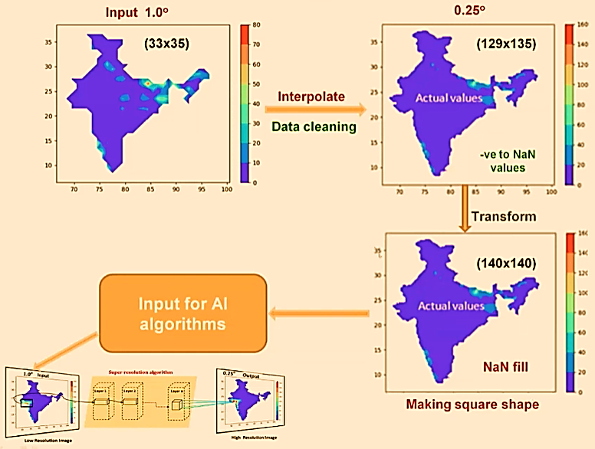
Data Preprocessing
Target: Creating 0.25-degree data from 1.0-degree IMD rainfall gridded data
Size of the extracted images is 35 x 35.
The patches are extracted at a stride of 23 to provide heterogeneity in the training set.
Got 64 sub-images for a particular day.
Total sub-images per year was 23360.

Slide 13
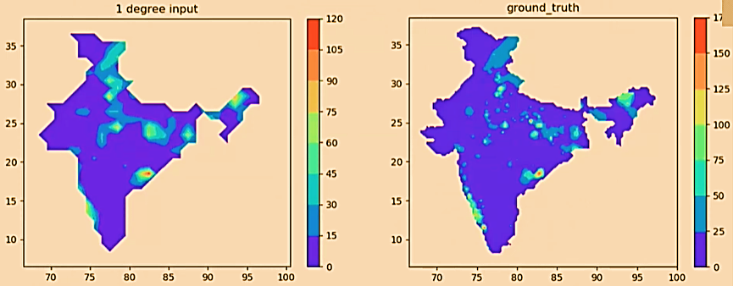
Training inputs:
Same input and label data used for training Stacked SRCNN model.

Slide 14
Results
Stacked SRCNN have been applied.
Data used
IMD Gridded Data
The target was to generate HR (High resolution) image
1.0◦ → 0.25◦
Resulted HR image compared with linear interpolation and ground truth.

Slide 15
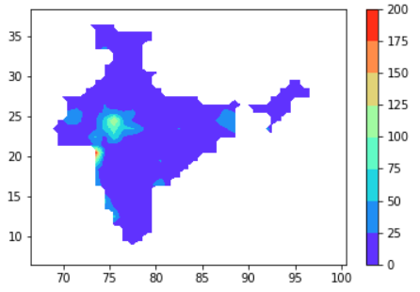
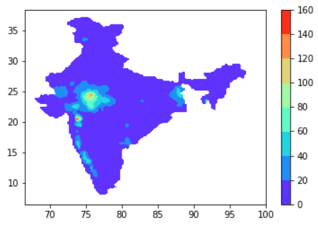
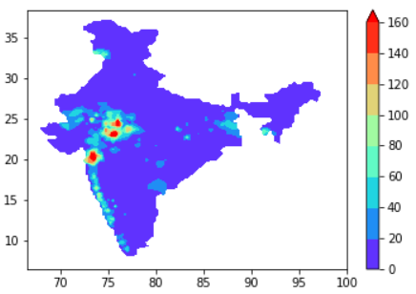
Comparison of results for a particular day:
Input 1.0◦ rainfall (got after doing linear interpolation on the existed actual 0.25 deg data)
Downscaled 0.25 ◦ rainfall with Stacked SRCNN
Actual 0.25 ◦ rainfall

Slide 16
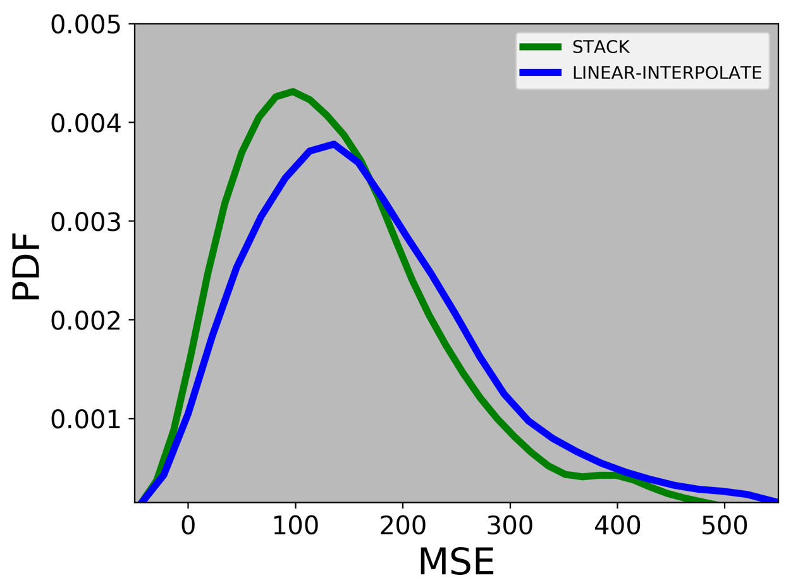
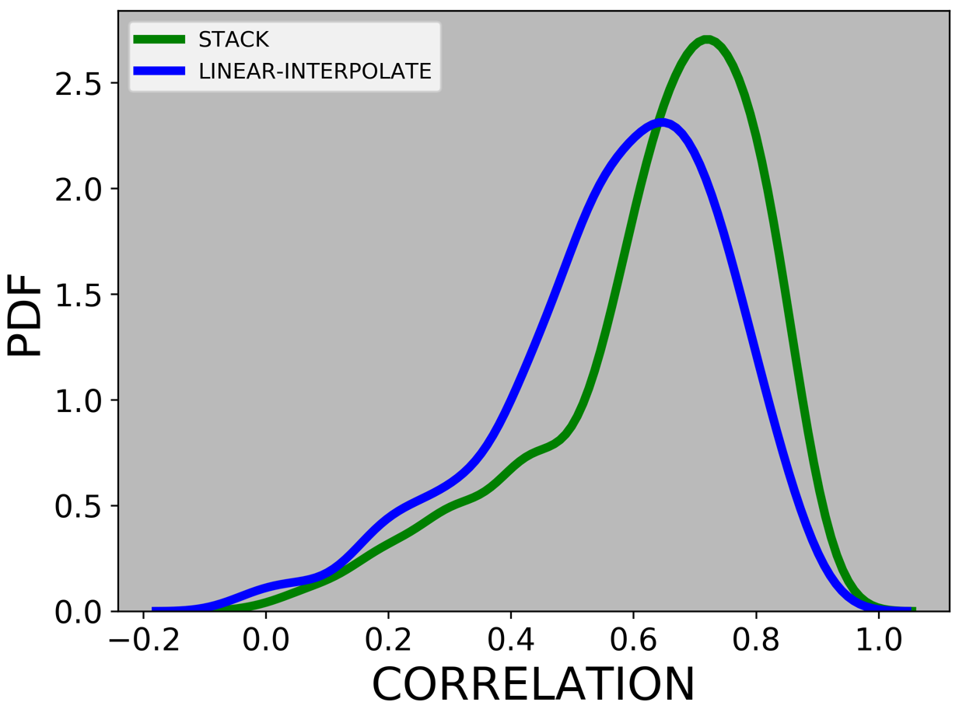
Statistical analysis:
Found that correlation is better in Stacked SRCNN, as compared to that of Linear interpolation.
Found that MSE is less in Stacked SRCNN compared to linear interpolation.

Slide 17
Conclusion
Meteorological data is attempted to downscale using deep learning techniques.
Stacked SRCNN technique is employed. To show better results, the technique must make use of multivariable, and the method is called DeepSD.
IMD 1 degree data is not from same stations as 0.25 degree.
This technique can be used to produce higher resolution maps/data obtained from model/observation.
Multivariable input is required during model training to improve the resolution by Stacked SRCNN.

Slide 18
References
Deep learning–based downscaling of summer monsoon rainfall data over Indian region(https://doi.org/10.1007/s00704-020-03489-6)
DeepSD: Generating High Resolution Climate Change Projections through Single Image Super-Resolution
Image Super-Resolution Using Deep Convolutional Networks
Image super resolution reconstruction based on improved invertible rescaling net
Image Super-Resolution Via a Convolutional Neural Network
Analyzing different types of activation functions in neural networks — which one to prefer? | by vikashraj luhaniwal | Towards Data Science
https://becominghuman.ai/basics-of-neural-network-bef2ba97d2cf

Slide 19
THANK YOU

